Slide 1
Making Excel Histograms
© McGraw Hill LLC. All rights reserved. No reproduction or distribution without the prior written consent of McGraw Hill LLC.

Slide 2
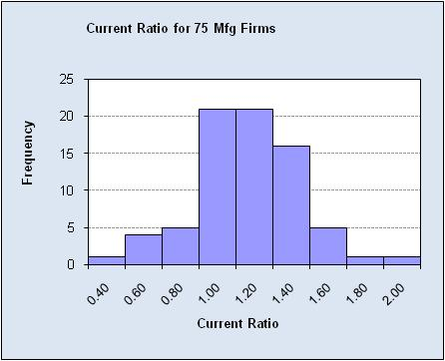

What is a Histogram?
A histogram is a column chart in Excel.
Column height (vertical axis) shows frequency.
Intervals (horizontal axis) show the x-values.
Intervals (called bins) are shown by x-axis labels.

Slide 3
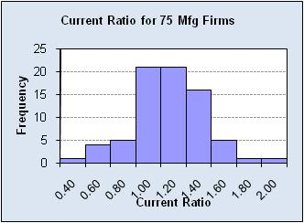
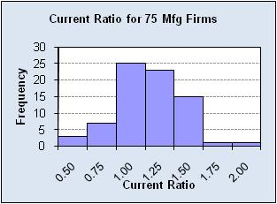
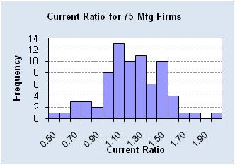
Bin Limits
Different bin limits may affect your perception of the distribution’s shape.

Slide 4
Raw Data
Raw data does not tell you very much about the shape of the distribution.
Note: Data show the "current ratio" for 75 small manufacturing firms. This measure of liquidity is defined as (current assets)/(current liabilities). If this ratio is below 1, the firm does not have enough assets to meet its liabilities and is insolvent. A ratio of 1.5 to 2 is generally considered desirable, while a ratio of more than 2 could mean that the firm too much money tied up in non-earning assets.

Slide 5
Three Ways
To make a histogram in Excel:
Method | Pro | Con
1. Quick Histogram | Easy | - Weird bins - No bin control
2. Data Analysis Tools | - Menu guidance - Option to set bins | - Weird histogram - Hard to edit
3. Do-It-Yourself | - Full control - “Live” histogram | - Requires editing - Uses array function

Slide 6
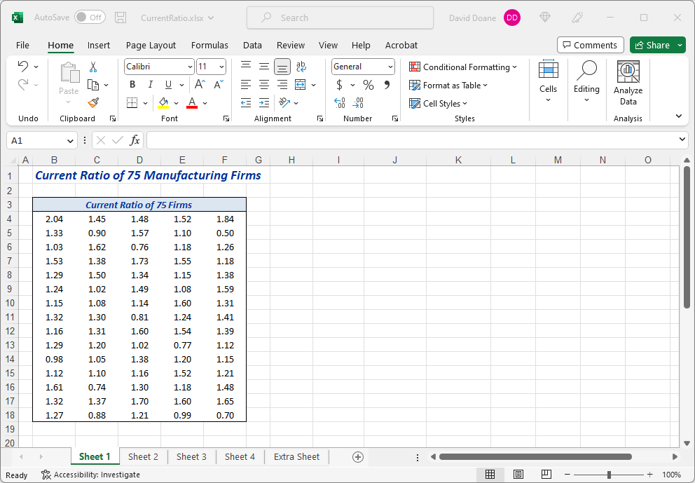
Data
Step 1: Enter the data.

Slide 7
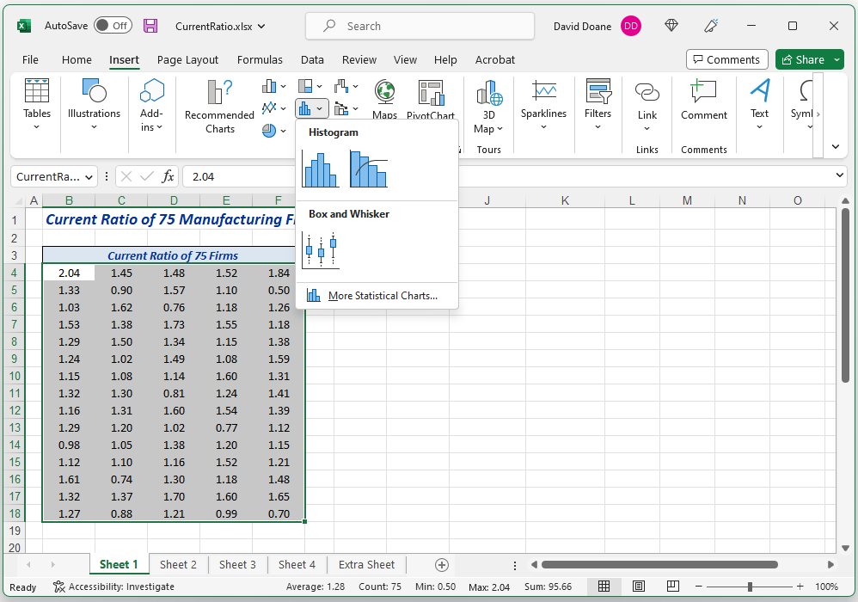
Quick Histogram
Step 2: Highlight the data, click Insert tab, select Statistics icon, and click Histogram.

Slide 8
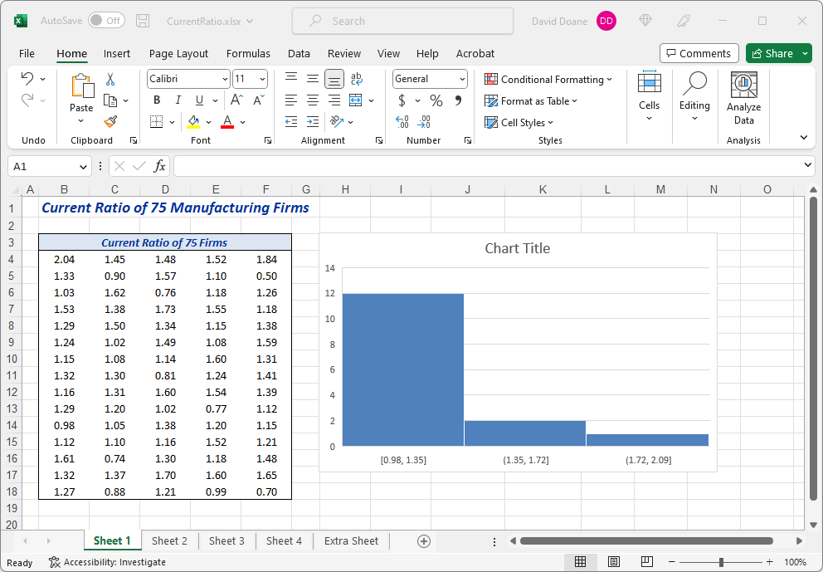
Quick Histogram
Step 3: Do you like the “quick” histogram?
Comment: Excel chose 3 bins, but Sturges’ Rule suggests 7 bins for n = 75:
k = 1 + 3.3 log(n)
k = 1 + 3.3 log(75)
k = 1 + 3.3 (1.875)
k ≅ 7 bins

Slide 9
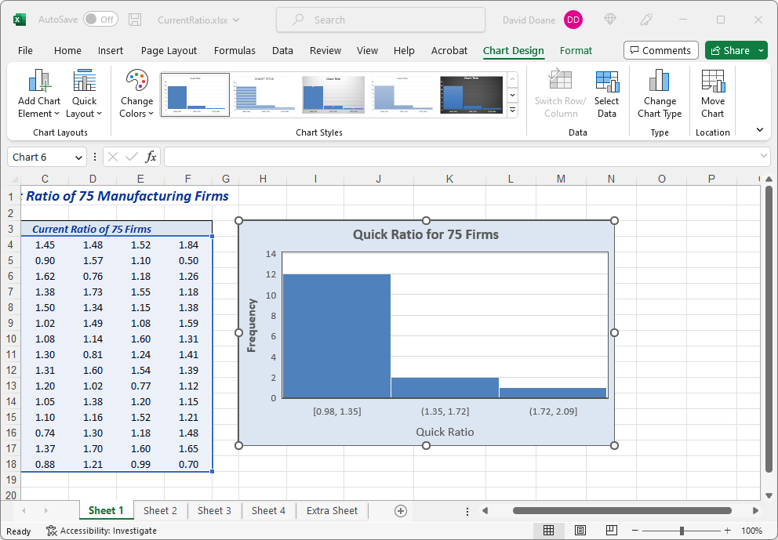
Quick Histogram
Step 4: Use the Chart Design tab to edit colors or add a title.

Slide 10
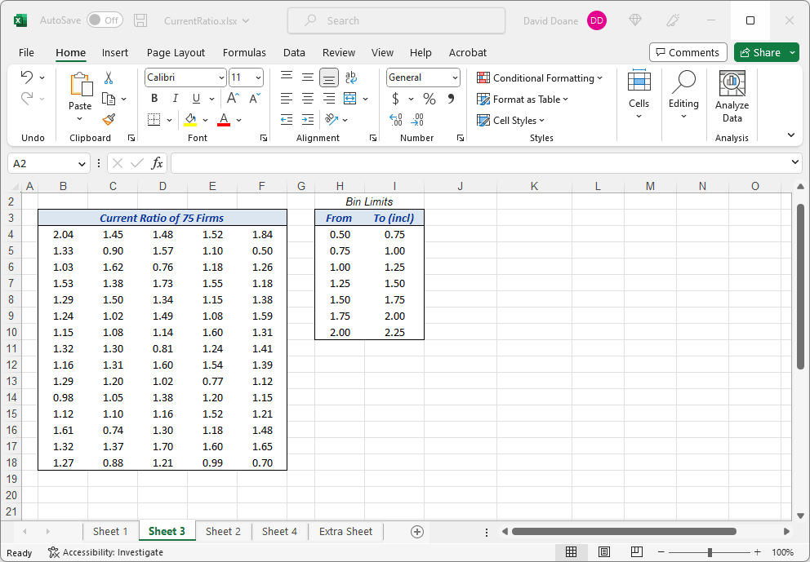
Data Analysis Tools
Step 1. Enter your own upper bin limits. Be sure to cover the data range. Excel includes the upper bin limit.
Comment: Only the upper bin limits are used for your histogram. But it’s a good idea also to create lower bin limits so you can interpret the intervals or use them as bin labels

Slide 11
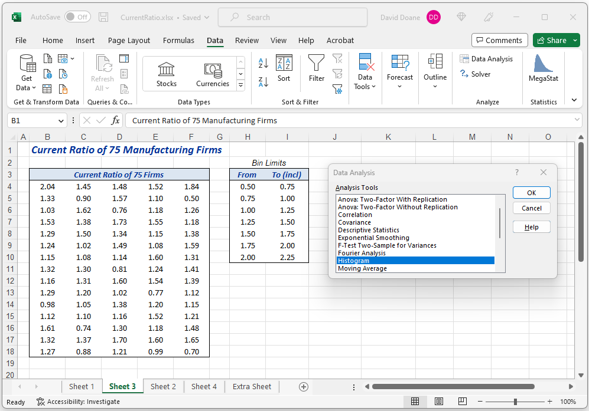
Data Analysis Tools
Step 2. On the Data ribbon, click Data Analysis and then choose Histogram.
Hint: If you don’t see Data Analysis you may need to install it.

Slide 12
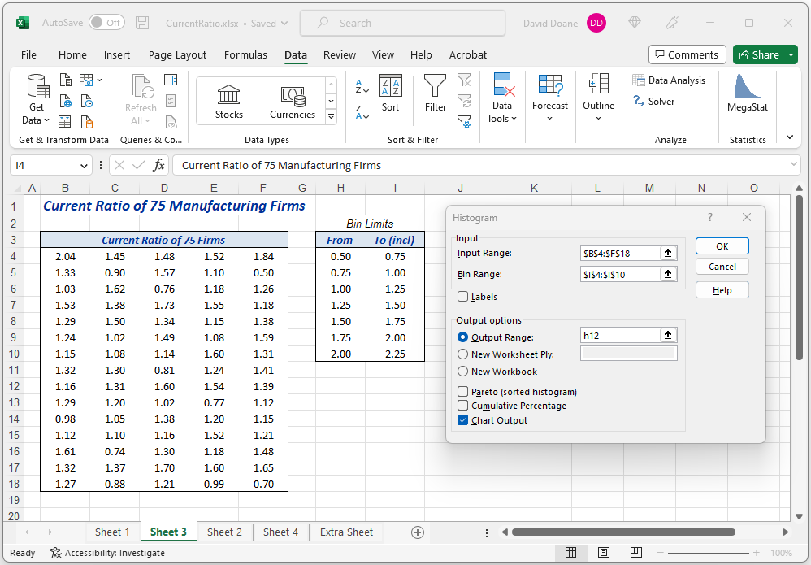
Data Analysis Tools
Step 3. Specify data range, upper bin limits, and output location. You must check Chart Output.

Slide 13
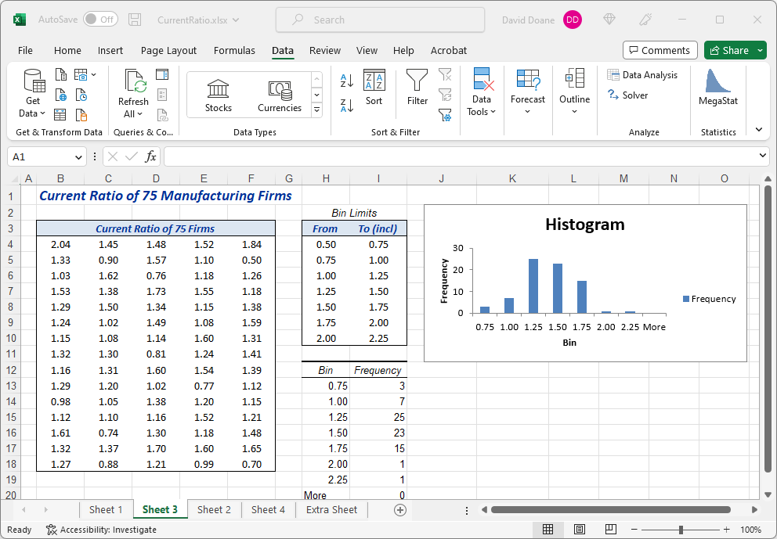
Data Analysis Tools
Step 4. You can edit the resulting chart (optional).
Comment: Excel's bin labels are centered on the bars rather than aligned with the tick marks. That’s weird, but you can’t do anything about it!

Slide 14
Do-It-Yourself
Step 1. Start by entering your own bin limits
Enter your bin upper limits (this limit will be included in the interval).
Comment: Only the upper bin limits are used for your histogram. But it’s a good idea also to create lower limits for clarity.

Slide 15
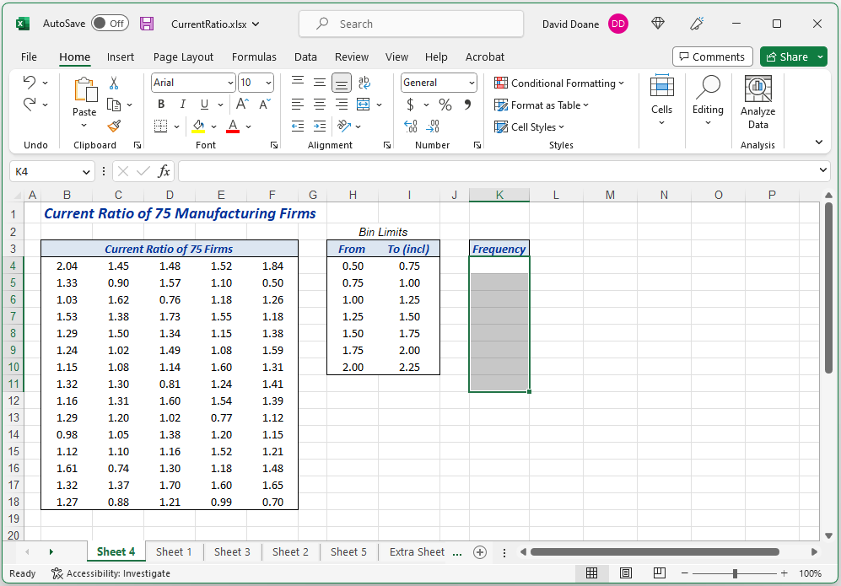
Do-It-Yourself
Step 2. Highlight an output range for your frequencies.

Slide 16
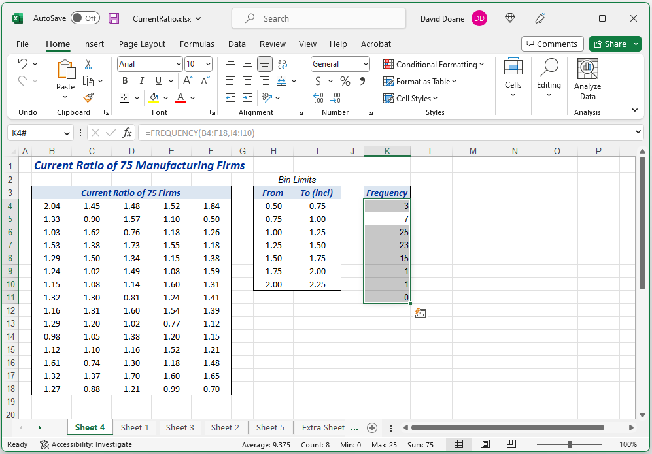
Do-It-Yourself
Step 3. Type array function =FREQUENCY(Data Range, Bin Upper Limits) and press Enter.
Hint: You can no longer edit a single cell in array K4:K10. You can only edit the entire array.
Note: The “squiggly brackets” indicate that you have successfully entered an array function.

Slide 17
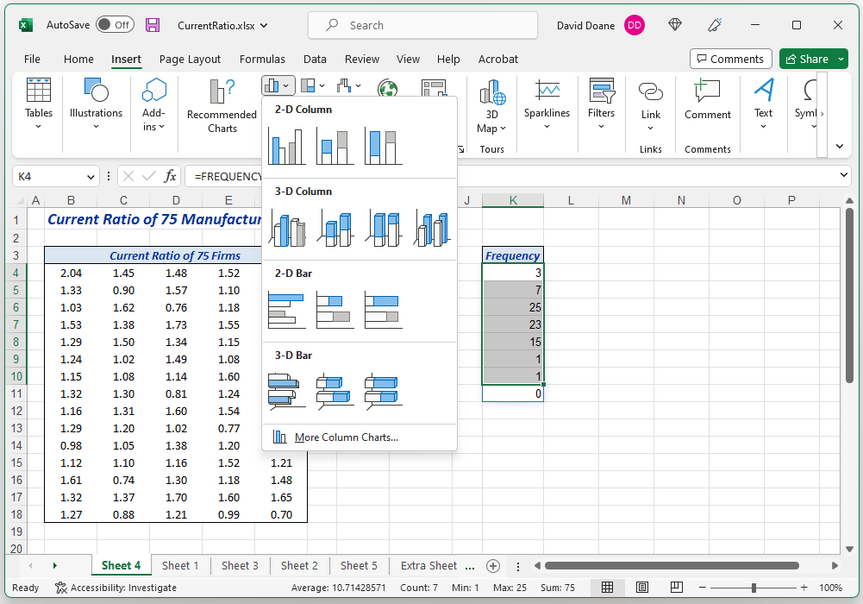
Do-It-Yourself
Step 4. Highlight frequencies, click Insert and choose a 2D Column chart.
Tip: The column chart is very plain, so you will want to customize it.

Slide 18
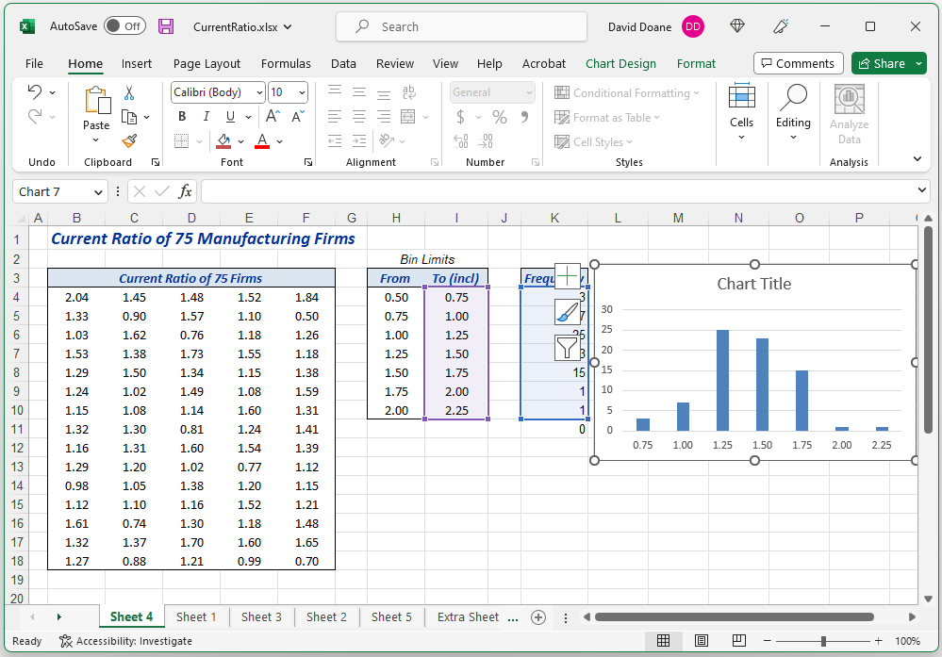
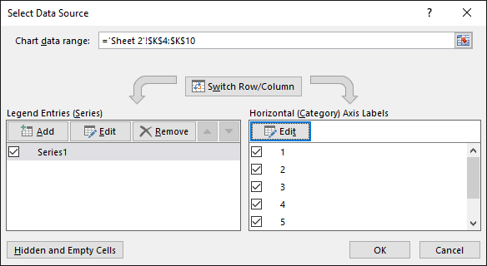
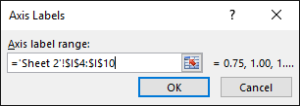
Do-It-Yourself
Step 5. Right-click on chart, choose Select Data, and specify horizontal axis labels (bin limits).

Slide 19
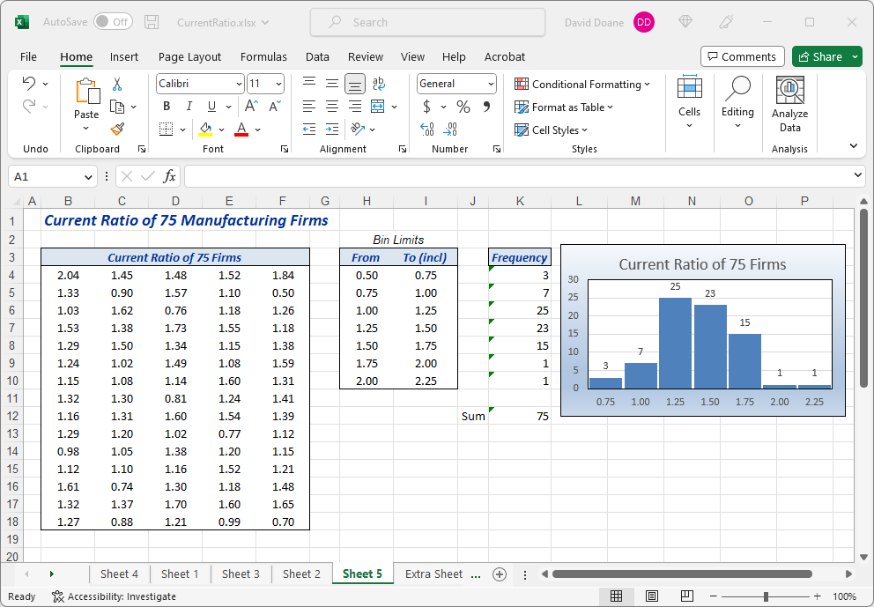
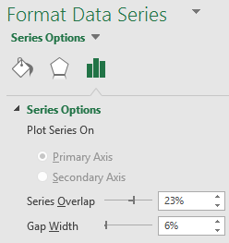
Do-It-Yourself
Step 6. Right-click on data and choose Format Data Series to adjust gaps between columns.
Tip: For clarity, put a tiny 5% to reveal separation between bars.

Slide 20

Do-It-Yourself
Step 7. Add a nice title, colors, and data labels to columns
Comment: Result is better than Excel’s default column chart, but horizontal axis labels are still centered on columns instead of at interval cut points. Try JMP or Minitab or R if you want a better histogram.

Slide 21

Bottom Line
Histograms are essential in data analysis.
Excel ‘s Data Analysis histogram is easy.
But its chart output is unattractive.
You can improve the chart.
But axis labels won’t line up with ticks.
Try using Minitab or JMP or R.

